Slide 1
Swift
OpenStack distributed object storage service

Slide 2
Swift
Swift is a widely-used and popular object storage system provided under the Apache 2 open source license.
Swift is designed to store files, videos, analytics data, web content, backups, images, virtual machine snapshots and other unstructured data at large scale with high availability and 12 nines of durability.
Notes:
According to the industry analyst firm Gartner, Swift is the most widely used OpenStack project as it is commonly used with other cloud computing frameworks and as a stand-alone storage system.

Slide 3
Characteristic
Swift is open-source and freely available
Swift currently powers the largest object storage clouds, including Rackspace Cloud Files, the HP Cloud, IBM Softlayer Cloud and countless private object storage clusters
Swift can be used as a stand-alone storage system or as part of a cloud compute environment.
Swift runs on standard Linux distributions and on standard x86 server hardware
Swift—like Amazon S3—has an eventual consistency architecture, which make it ideal for building massive, highly distributed infrastructures with lots of unstructured data serving global sites.
All objects, or files, stored in Swift have a URL
Applications store and retrieve data in Swift via an industry-standard RESTful http API
Objects can have extensive metadata, which can be indexed and searched
All objects are stored with multiple copies and are replicated in as-unique-as-possible availability zones and/or regions
Swift is scaled by adding additional nodes, which allows for a cost-effective linear storage expansion
When adding or replacing hardware, data does not have to be migrated to a new storage system, i.e. there are no fork-lift upgrades
Failed nodes and drives can be swapped out while the cluster is running with no downtime. New nodes and drives can be added the same way.

Slide 4
Eventual Consistency
Eventually Consistent Storage Systems | Strongly Consistent Storage Systems
Amazon S3 OpenStack Swift | Block storage Filesystems

Slide 5
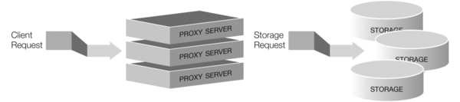
Swift Overview—Processes
Four Swift server processes: proxy, account, container and object.

Slide 6
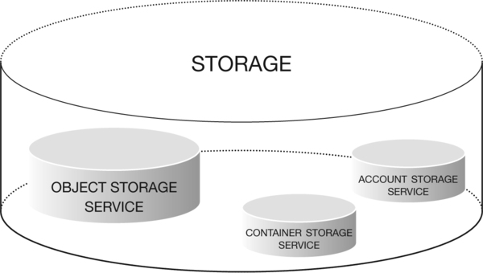
Storage Services

Slide 7
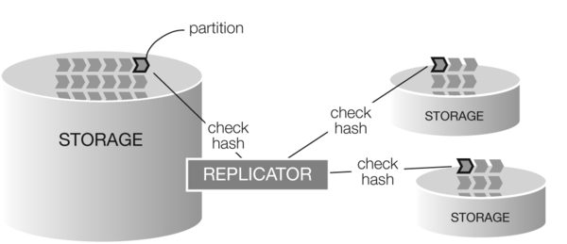
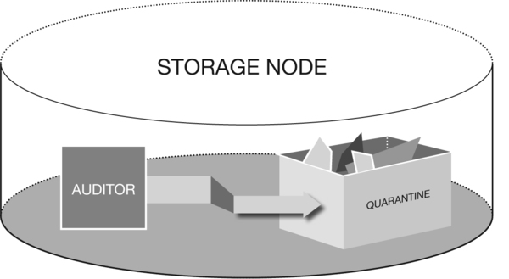
Consistency Services
Auditors
Replicators
Container and Object Updaters
Account Reaper
Notes:
The replicator also handles object and container deletions.
When an account reaper service makes its rounds on a node and finds an account marked as deleted, it starts stripping out all objects and containers associated with the account. With each pass it will continue to dismantle the account until it is emptied and removed. The reaper has a delay value that can be configured so the reaper will wait before it starts deleting data—this is used to guard against erroneous deletions.

Slide 8
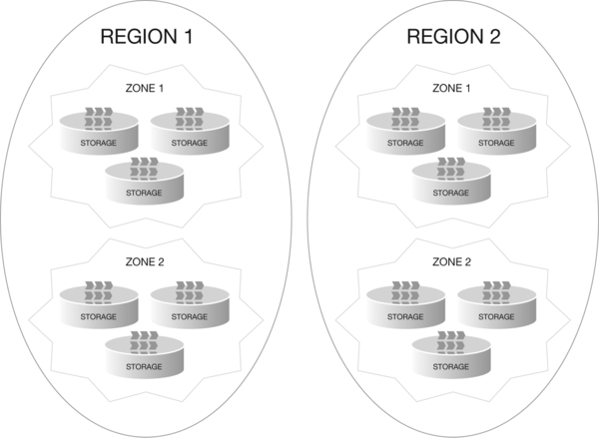
Cluster Architecture
Nodes
Regions
Zones
Notes:
Regions are user-defined and usually indicate when parts of the cluster are physically separate --usually a geographical boundary. A cluster has a minimum of one region and there are many single region clusters as a result
Within regions, Swift allows allows availability zones to be configured to isolate failure boundaries. An availability zone should be defined by a distinct set of physical hardware whose failure would be isolated from other zones.

Slide 9
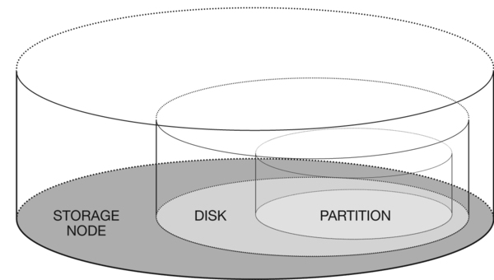
Data Placement - Partitions
Storage nodes have disks. Partitions are represented as directories on each disk.

Slide 10
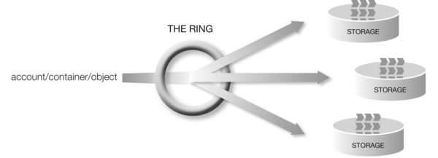
Data Placement - Replicas
An object ring enables a path /account/container/object path to be mapped to partitions.
Most commonly a replica count of three is chosen.

Slide 11
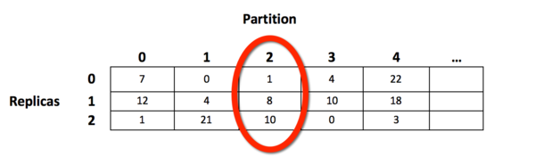
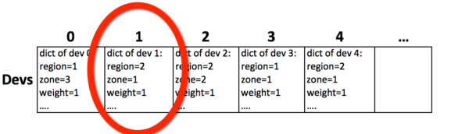
Data Placement - Ring
Modified consistent hashing ring
Two important internal data structures: the devices list and the devices lookup table
Replica Count, Replica Lock, Weight, Unique-as-possible Placement
Notes:
The ring-builder assigns partitions to devices and writes an optimized Python structure to a gzipped, serialized file on disk for shipping out to the servers.

Slide 12
Build a ring
cd /etc/swift
swift-ring-builder account.builder create 18 3 1
swift-ring-builder container.builder create 18 3 1
swift-ring-builder object.builder create 18 3 1
export ZONE= # set the zone number for that storage device
export STORAGE_LOCAL_NET_IP= # and the IP address
export WEIGHT=100 # relative weight (higher for bigger/faster disks)
export DEVICE=sdb1
swift-ring-builder account.builder add z$ZONE-$STORAGE_LOCAL_NET_IP:6002/$DEVICE $WEIGHT
swift-ring-builder container.builder add z$ZONE-$STORAGE_LOCAL_NET_IP:6001/$DEVICE $WEIGHT
swift-ring-builder object.builder add z$ZONE-$STORAGE_LOCAL_NET_IP:6000/$DEVICE $WEIGHT
swift-ring-builder account.builder rebalance
swift-ring-builder container.builder rebalance
swift-ring-builder object.builder rebalance

Slide 13
Requests
A storage URL in Swift for an object looks like this:
https://swift.example.com/v1/account/container/object
Open–source client libraries are available for most modern programming languages, including: Python, Ruby, PHP, C#/.NET, Java, JavaScript
http://docs.openstack.org/api/openstack-object-storage/1.0/content/

